Slide 1

Password Manager: Safeguard Your Digital Life
Welcome to our presentation on Password Manager, a powerful tool designed to secure your online presence and protect your valuable data. We'll explore its key features, benefits, and how it safeguards your digital life.

Slide 2

Problem Statement
In today's digital landscape, data breaches are becoming increasingly common. This presents a significant risk for individuals who reuse the same passwords across multiple accounts. Password managers are essential to protect against these threats and simplify credential management.

Slide 3
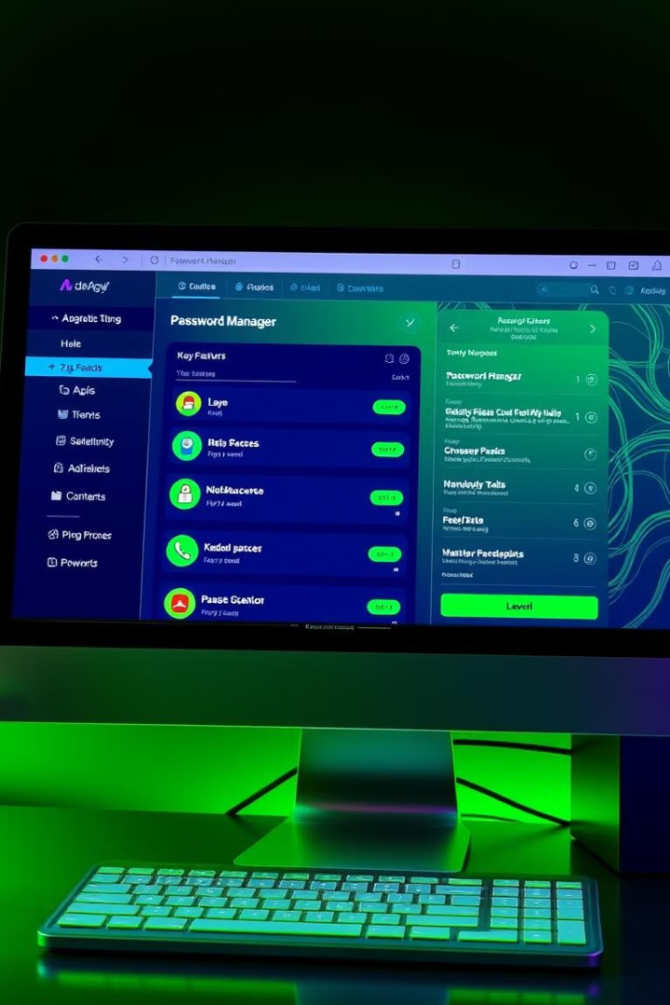
Solution: Securely Manage Your Credentials
Password Manager offers a comprehensive solution to protect your online accounts and simplify your digital life. It securely stores, manages, and protects your credentials, giving you peace of mind in the digital world.

Slide 4
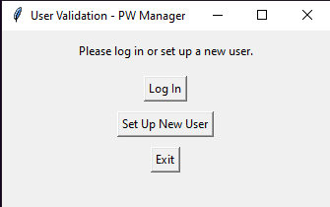
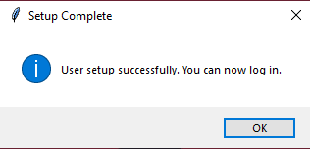
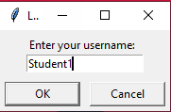
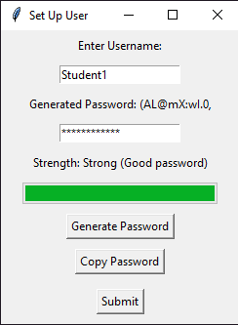
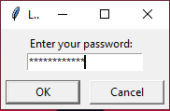
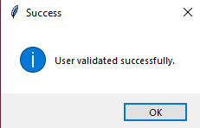
Secure Logins with MD5 Hashing
Enhanced Security
MD5 hashing transforms your password into a unique code, preventing unauthorized access to your credentials.
Unbreakable Encryption
This irreversible process ensures that your password cannot be retrieved, even if the database is compromised.

Slide 5
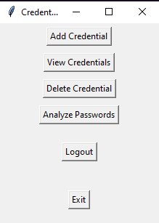
Store, View, and Manage Your Credentials
Centralized Storage
Easy Access
View, edit, and manage your credentials effortlessly with a user-friendly interface.
Password Manager provides a secure vault to store all your logins, usernames, and other sensitive information.
Organized Management
Categorize and search for specific credentials efficiently, making it easy to find what you need.

Slide 6
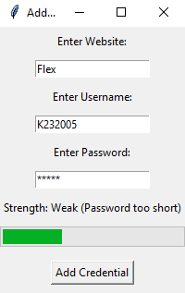
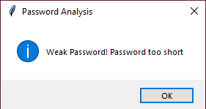
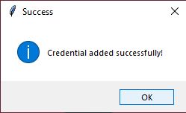
Add Credentials

Slide 7



Filter Saved Credentials
Search by Website
Search by Username
Quickly find your credentials by searching for the website name.
Locate the desired credentials using the associated username.

Slide 8
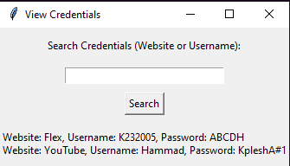
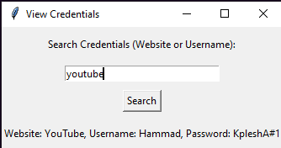
View Credentials & Filter out by input
Simply, click on “View Credentials” It will list out all the credentials saved in your account.
To filter out the credentials, write the website name or username in the search bar.

Slide 9
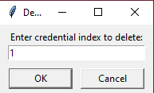
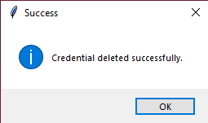
Delete Credentials
Similar, you can easily delete your credentials.
Simply, click on the “Delete Credentials” button and type in the index of the credentials that you want to delete.
Once you do that, the credential will be deleted from the database and the UI.

Slide 10



Secure Password Storage with RSA Encryption
RSA Encryption
1
RSA encryption utilizes public and private keys to securely encrypt your data.
Key Generation
2
The software generates unique keys, ensuring data protection.
Secure Storage
3
Your private key is securely stored, making it impossible for unauthorized access.

Slide 11
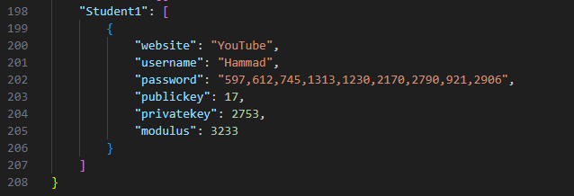
Credentials Database
The credentials data is stored in credentials.json
The password is encrypted using RSA algorithm and securely stored in the database.

Slide 12
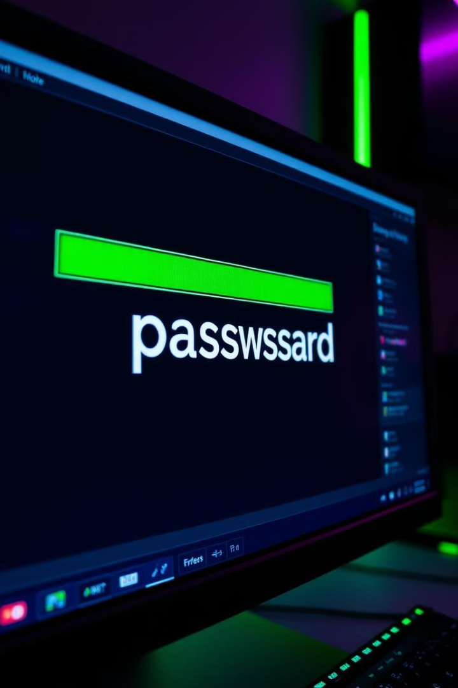
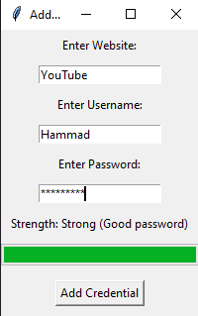
Password Strength Analysis
1
Strength Meter
2
Security Recommendations
Our tool analyzes your passwords and provides a strength rating based on complexity and length.
Get suggestions for strengthening weak passwords, ensuring optimal security.
3
Password Audit
Perform regular audits to identify and rectify any vulnerabilities in your password choices.

Slide 13
Thank you!

